Slide 1

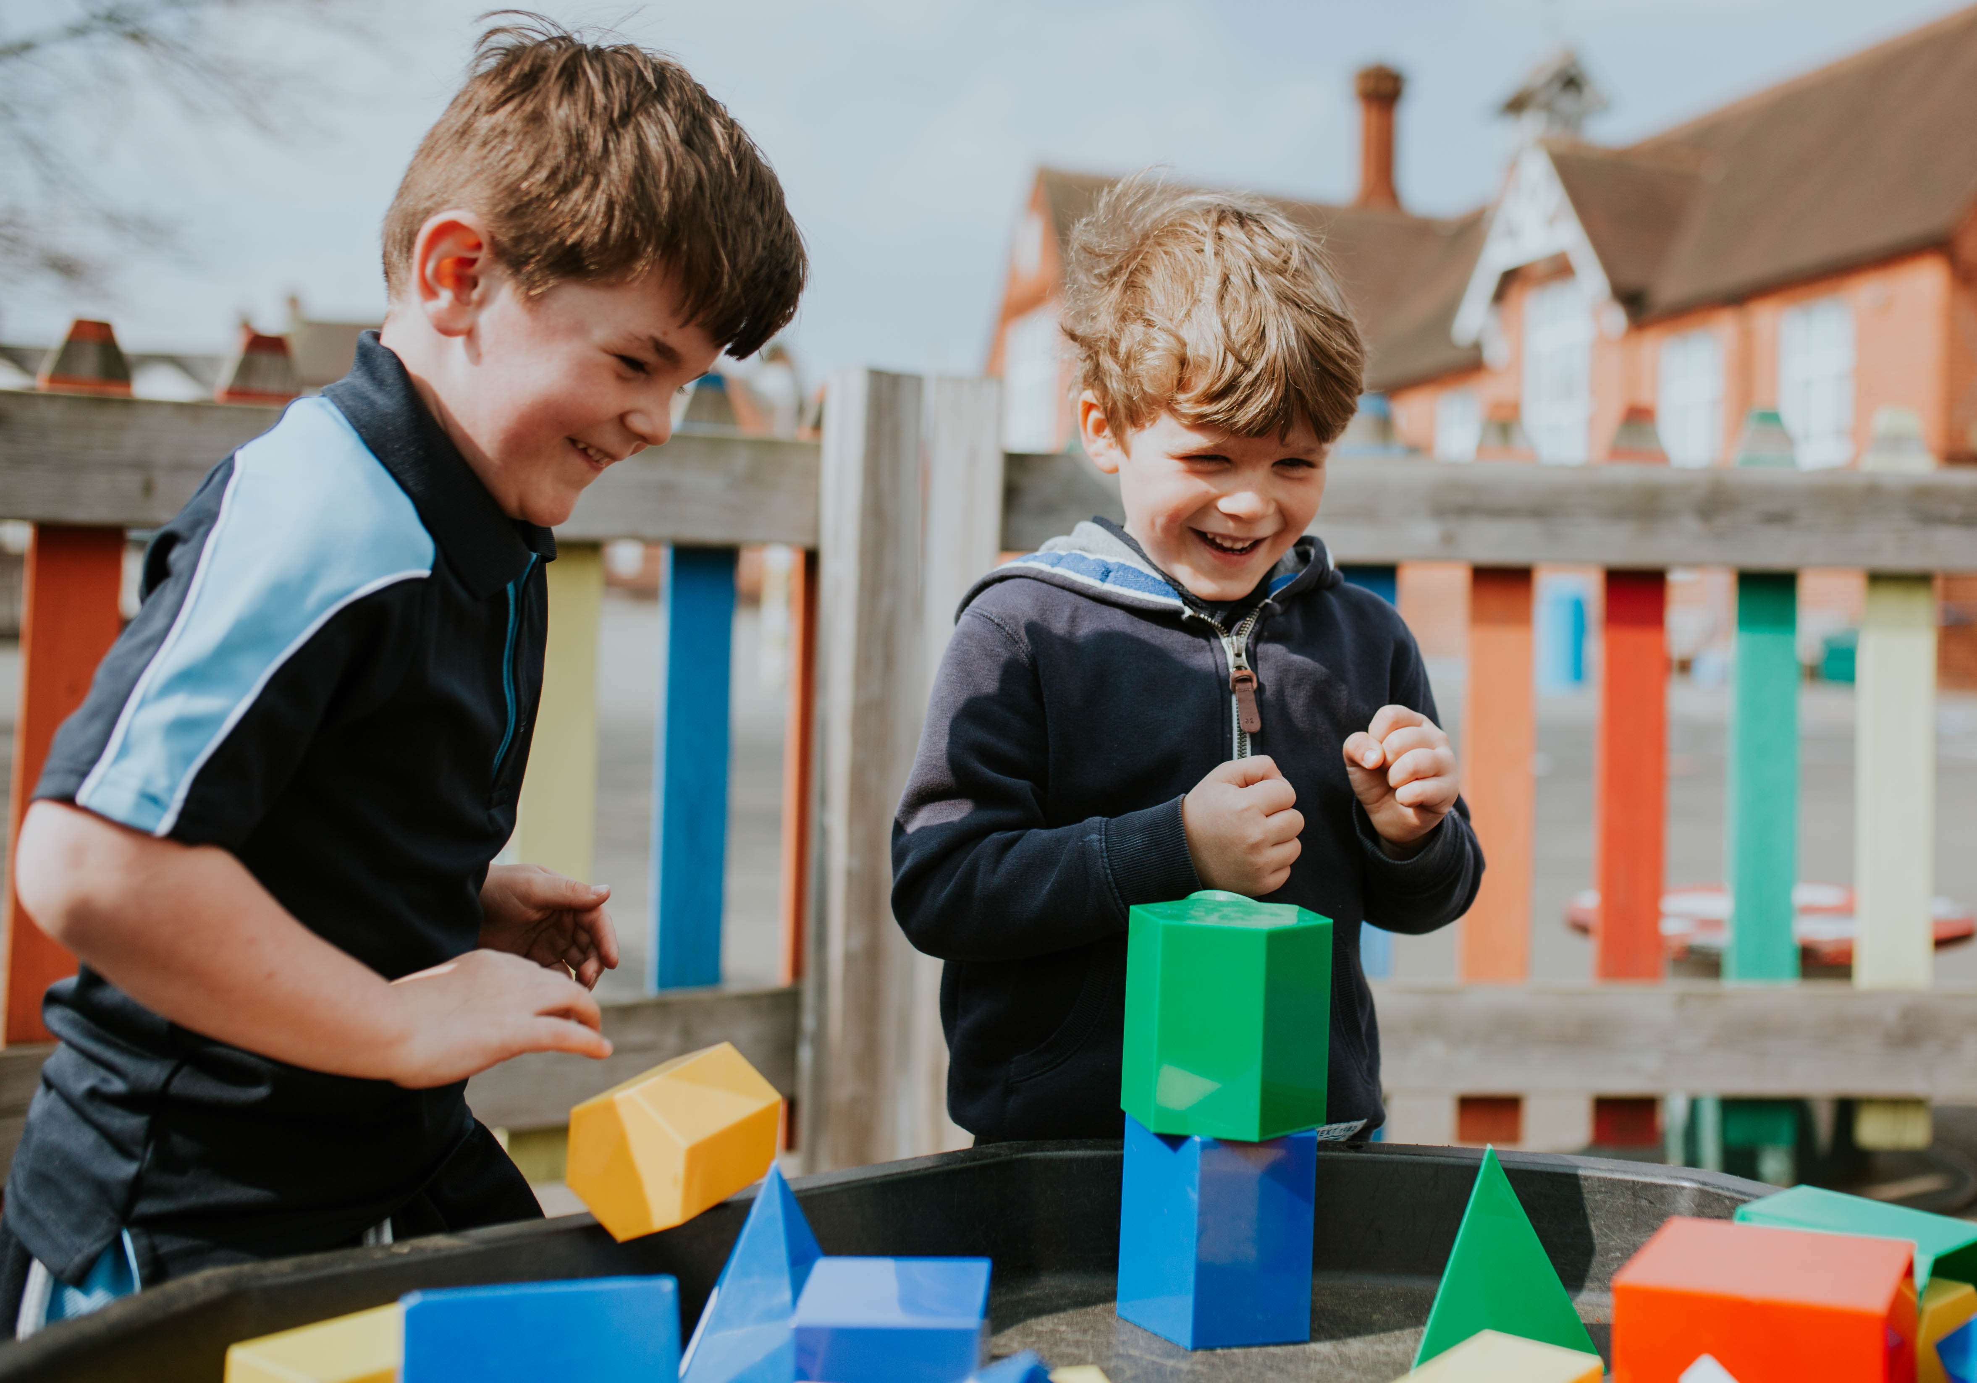
Welcome
Here at St Michael’s, we recognise that every child is unique and therefore special

Slide 2
Aims of today…
See and spend some time in our learning environment
Find out arrangements for your child starting Reception- receive welcome packs, meet PTA, and look at uniform
Meet your peers, other parents and staff who will be working closely with your child
Learn a little bit more about a typical day
Find out how you can support your child to be an independent learner

Slide 3
Starting school
Starting school is an exciting time, but it can also be a daunting time too. Hopefully your visit today will provide you all with some reassurance for the next stage of your child's learning journey.
Your child doesn’t need to be able to read, write or do sums before they start school. Children start school with a wide range of abilities and our job is to work with your child to progress at their own level and provide them with…
The high quality education that all children deserve.
It's called the Early Years Foundation Stage for a reason! Imagine a child's learning like a house; get the foundations right and you stand a good chance of building a solid structure.

Slide 4

Learning and development covers the 7 key areas of learning within the Early Years Foundation Stage (EYFS), which are:
Personal, social and emotional development.
Communication and language.
Physical development.
Literacy.
Mathematics.
Understanding the world.
Expressive arts and design.
Dfe statutory baseline assessments are started in the first six weeks of school and a final profile in June

Slide 5
Our strengths are:
Showing them love, care, security and ‘awe and wonder’ experiences
A happy, safe and secure learning environment
Establishing strong, positive relationships
You have been your child's main educators- our job is to work WITH YOU!
The Dfe EYFS statutory framework is followed with a theme in each term to connect the learning with hands on experiences

Slide 6
Staff
Mrs Tiley – class teacher and EYFS lead(4 days)
Mrs Williams – class teacher (1 day)
Miss Ashleigh – teaching partner
Mrs Watkinson – HLTA
Mrs Wyatt – teaching partner

Slide 7
A typical day in class …
8:35- 8:50- soft start, fine motor skills, memory games, maths and literacy activities followed by registration and assembly
9:10-9:35 Read Write Inc Phonics session
9:35- 10:15 Literacy input leading into child initiated activities
10:10- 10.45 snack followed by playtime with Y1 and Y2
10:50-11.40 Maths input leading into child initiated activities
11:50- 1:00 Lunchtime followed by playtime
1:00 register/cool down/mindfulness
1.15- Topic input, followed by child initiated activities, teacher work with small groups
2:30 – 3:15 tidy up time, snack, story and prep for home
PE and library visits once a week- Show and Tell is Friday in the autumn term only

Slide 8
Contact with parents
A teacher is available to speak to at the playground gate morning and afternoon
Updates via our class reps on a Whats App group
Keep up to date with our learning on our school Facebook page
Please report absences to the office by 9:30am
The school office will keep you informed of upcoming events, please make sure if you change address or phone numbers, you notify us

Slide 9
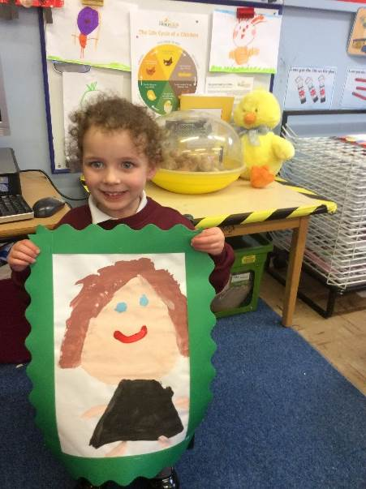
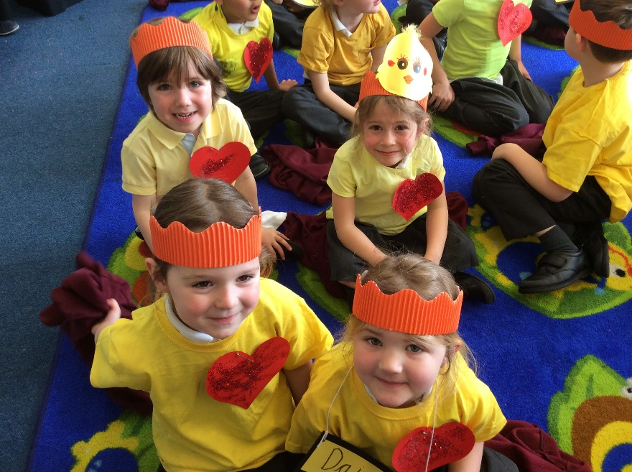
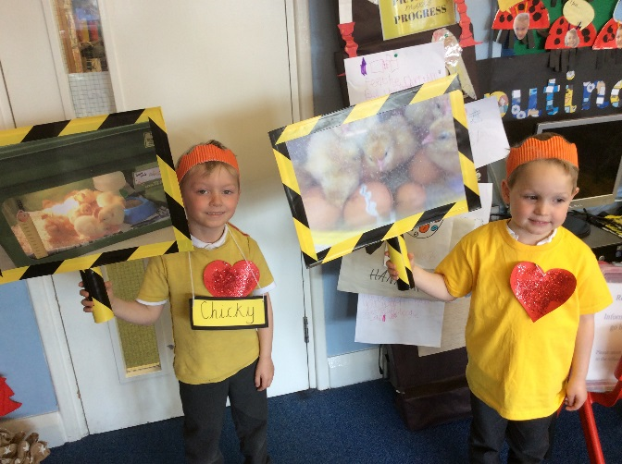
WE LOVE TO SHOW OFF!
Performances throughout the year – Christmas nativity and class assembly in the summer term
You are invited to share the children’s books with you during the year
School visits to church

Slide 10
What can you do to help your child’s learning when they begin school?
Putting on coats, jumpers, cardigans, socks and shoes
Recognising/writing name and holding a pencil
Spending time talking to your child to develop a conversation, keep screen time to a minimum and not before bedtime
Encourage mark making, writing simple shopping lists
Having enough sleep is crucial to attentive learning
Practise counting at any time-climbing the stairs, shopping etc.
Play simple board games to take turns and share
Sing number rhymes and songs together
Apart from Show and Tell home toys should be left at home

Slide 11
Snacks and drinks
Fruit and vegetables are available each day
Additional snacks are allowed but must be low sugar and NUT FREE
Water bottles must be named and filled with fresh water not squash or juice
Birthday treats should be shared at the gate directly with parents to give their children at the end of the day, rather than sent into class
School lunches are healthy, there are 3 choices, dietary requirements should be reported to the school office for caterers

Slide 12
Other matters…
Please let us know if someone different is collecting your child!
Workshops for phonics/ reading will happen at the start of the year when you are invited in to learn how we teach phonics
Trainers are not to be worn in place of school shoes unless its is PE. Sunhats are required and suncream applied at home
Medical
Any sickness, diarrhoea, must be followed by 48 hours absence from last episode.
Please check your child for head lice
Any prescribed medication can only be administered by the office with prior arrangement
Please complete the Find Out About Me and starter pack forms

Slide 13
No back packs- school books bags only with a change of underwear and socks in
1 keyring on their book bag/ PE bag for easier identification
All uniform must be clearly named
Wellington boots will only be required for school trips if necessary
Sound packs will be sent home towards half term to learn, reading books will follow when your child is ready. It is really important to complete any work with your child to ensure they reach their potential

Slide 14


Slide 15

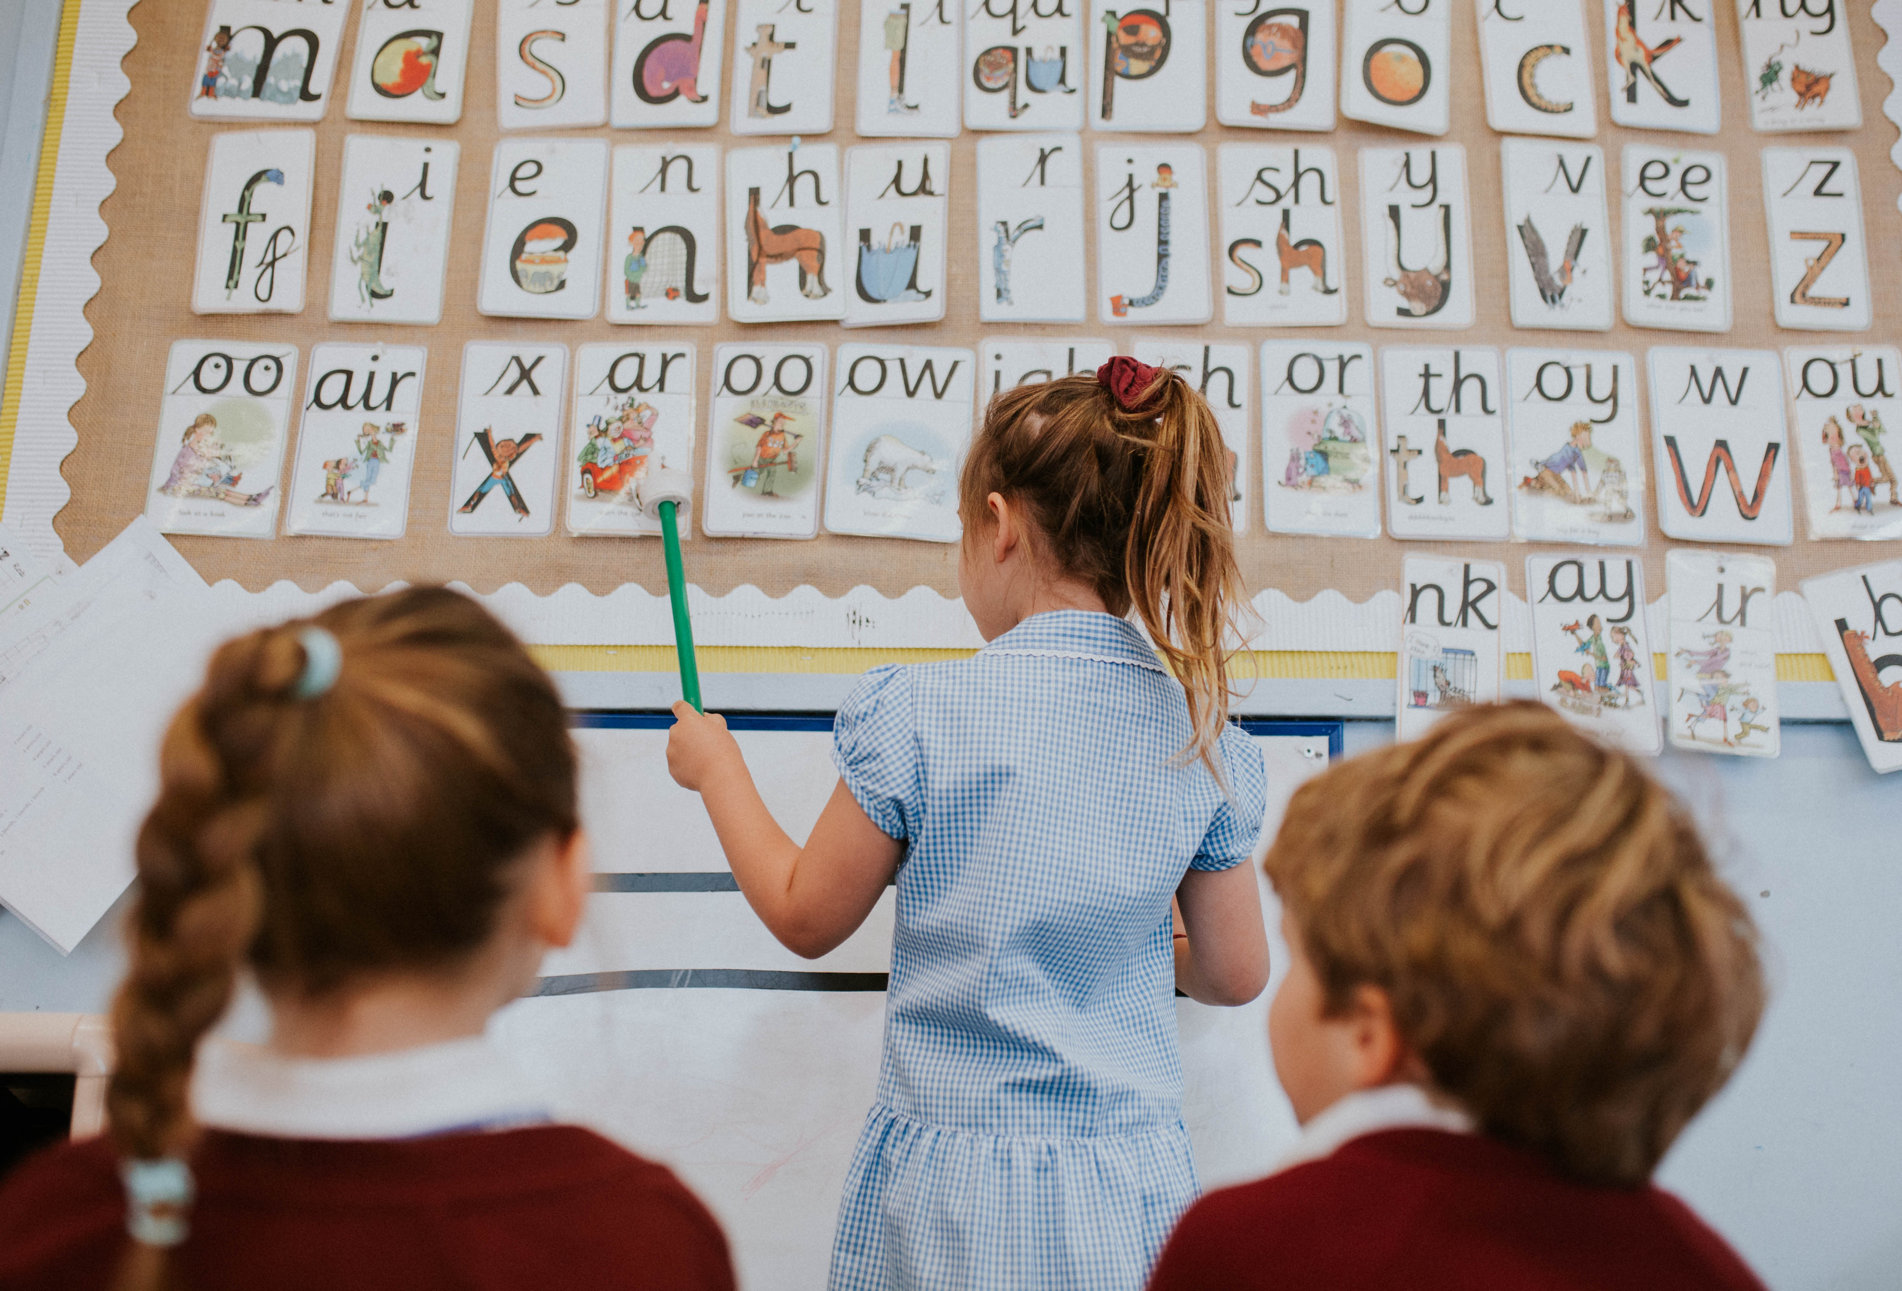
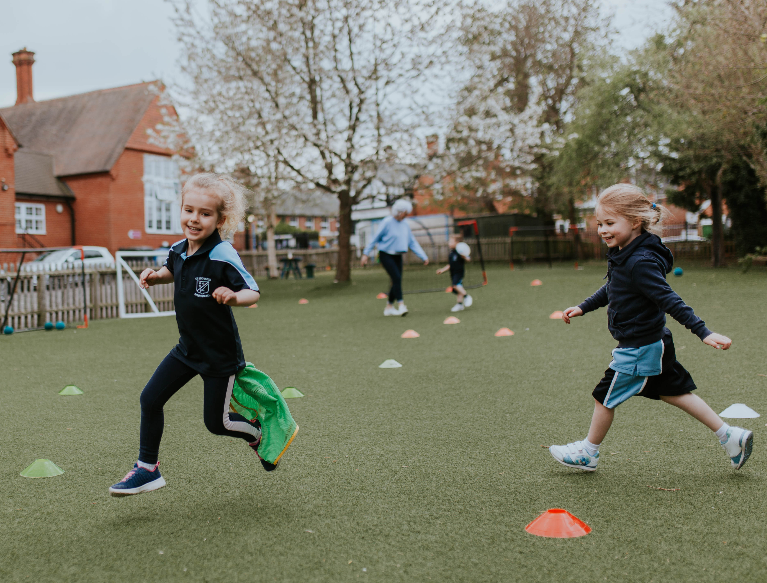
Thank you
Questions …

