Slide 1
Meet the teacher
Year 4
Miss Tomes

Slide 2
Y4 expectations
High expectations of behaviour and learning – following the
school values (Respect, Kindness, Curiosity and Faith).
Packed lunches, water bottles and weather appropriate clothing.
• Fundamental SPAG – Full stops, capital letters should be
embedded.
• Reading daily, both at home and in school. Reading records will
be checked weekly.
• Times tables practice.
Notes:
Alter as appropriate for your year group

Slide 3
timetable
PE will be Monday and Friday.
Generally, English and Maths in the mornings and foundation subjects in the afternoons
Gates open at 8.35 and it is important that children are in school as promptly as possible as we start our learning during morning motivation
Notes:
Alter as appropriate for your year group

Slide 4
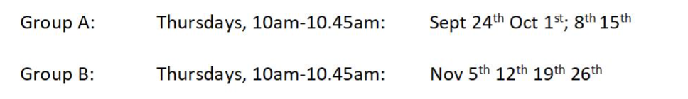
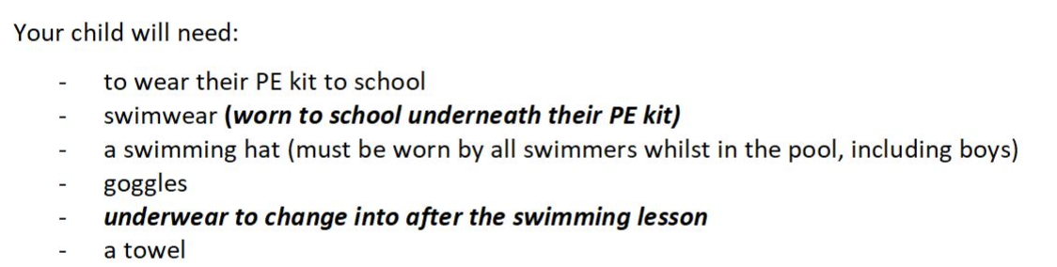
Swimming
Swimming will be every Thursday.
Group A will start on 24th September.
Group B will start on 5th October, after half term.
Notes:
Alter as appropriate for your year group

Slide 5
Assessments
We carry out assessments in school at the end of Autumn, Spring and Summer Terms.
• There will be 2 parent evenings
• After Christmas and Easter, this will just be a letter sent to you of where your child is in relation to age-related
expectations:
• WTS – working towards the expected standard
• EXS – working at the age-related expected standard
• GDS – working at greater depth
• In the summer term, this will be a full written report.
Children start a new set of objectives each year, so they won’t necessarily be achieving EXS in the autumn – this doesn’t mean they aren’t on track for achieving EXS

Slide 6
Times Tables
The MTC is a check consisting of 25 times tables questions competed online
Baseline
Will do extra practice in the spring/ summer term
• No pressure for children!
• Please use TT Rockstars sound check
The multiplication tables check will take place in June 2027.
Notes:
Alter as appropriate for your year group

Slide 7
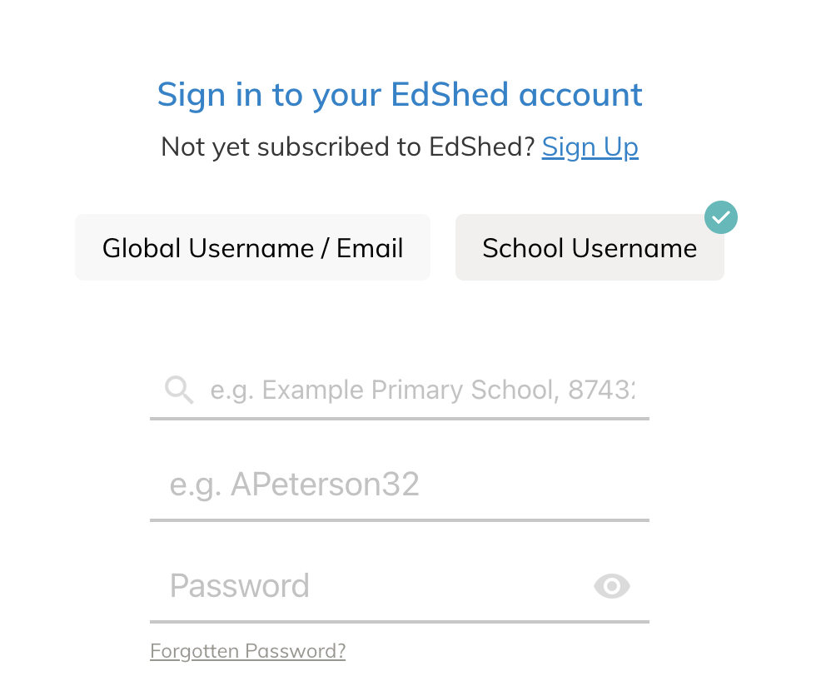
Homework
Maths Homework – Set on a Thursday.
Spellings practice – Set on Ed Shed. Log ins in their reading records. Link on Class homework page.
Brain builders once a term
Notes:
KS1, Y3 and 4 – reading record info

Slide 8
Reading
Children should be reading at home as much as possible
Reading at home needs to be recorded or signed by an adult.
When they have completed a book, they will come in and completed accelerated reader for that book before they change it.
Notes:
Alter as appropriate for your year group

Slide 9
Important Dates
Bikeability – Friday 25th September
School Photos – Tuesday 6th October
Year 4 Class Assembly – Wednesday 21st October

Slide 10
THANK YOU

