Slide 1
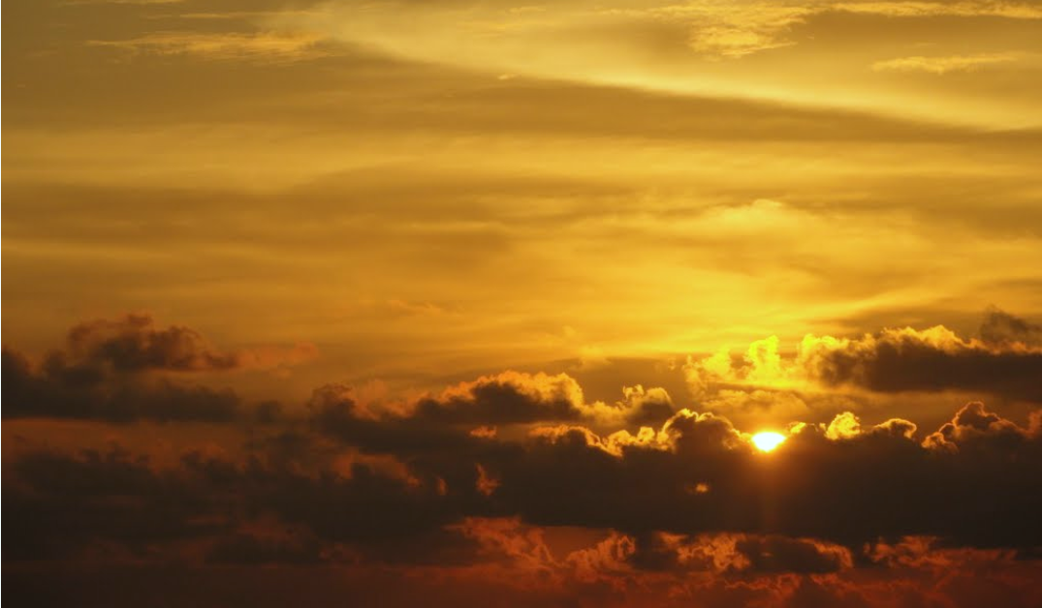
Our Vision
‘Learning together through love, friendship, forgiveness and faith’ are the golden threads that are woven throughout our daily lives in school. With our values, the 6R’s, we aim to prepare and ensure our children live their lives according to the teachings of Jesus.
‘For we walk by faith, not by sight’
2 Corinthians 5:7

Slide 2
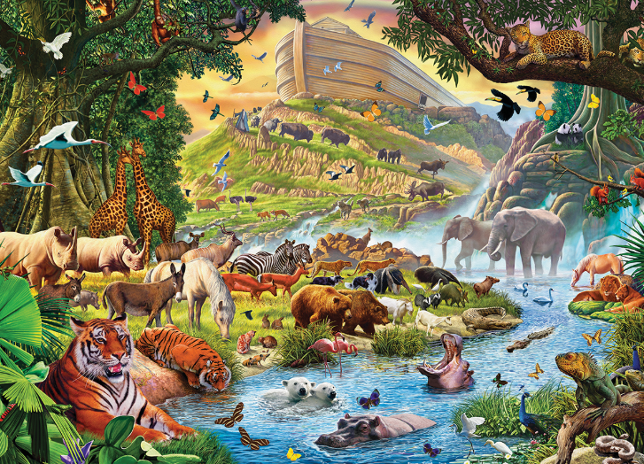
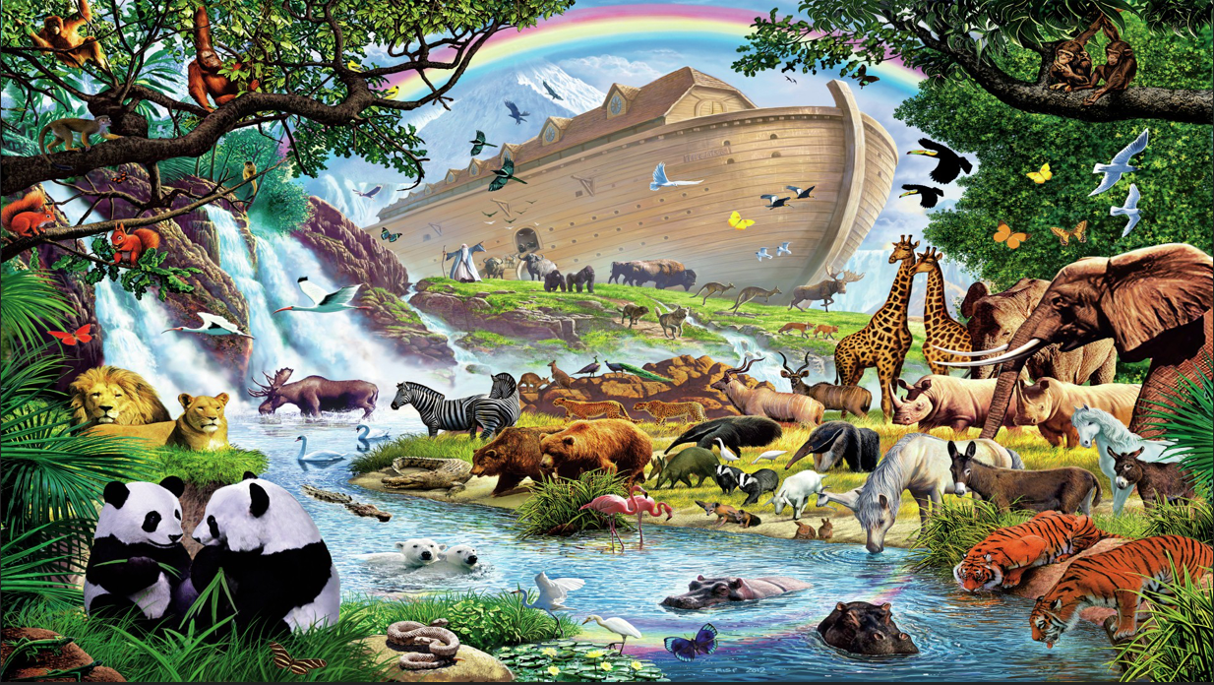
Let’s learn more about our school vision through the story of
Noah and the Ark

Slide 3
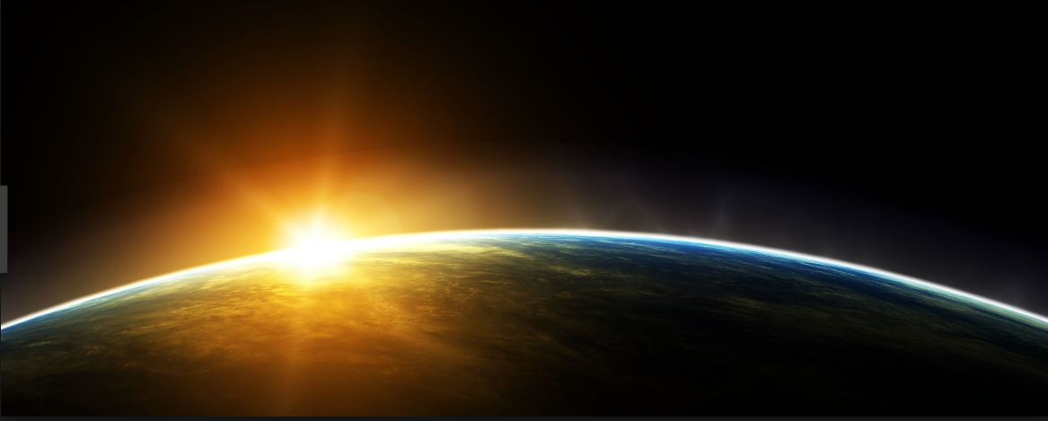
In the beginning God created a perfect and wonderful World filled with love

Slide 4
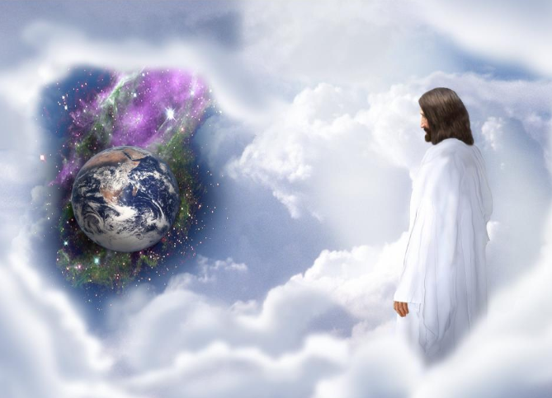
But many years later when God looked down on the Earth people did not respect the world or each other.
This made God sad.
One man above all others was good, honest and trusted by God. His name was Noah.

Slide 5
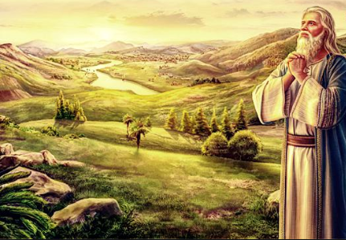
Noah was a good friend, kind and loving.

Slide 6
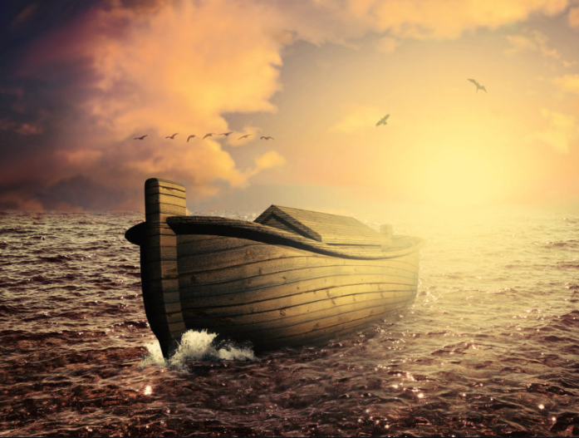
So, one night God spoke to Noah in a dream.
“I am going to flood the world and wash it clean again” God told Noah
“You will need to build a huge wooden ark to save your family and two of every living creature.

Slide 7
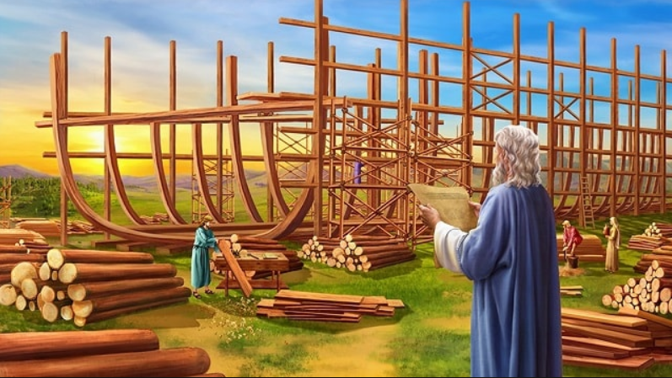
Noah had faith in God and started to build the Ark straight away.

Slide 8
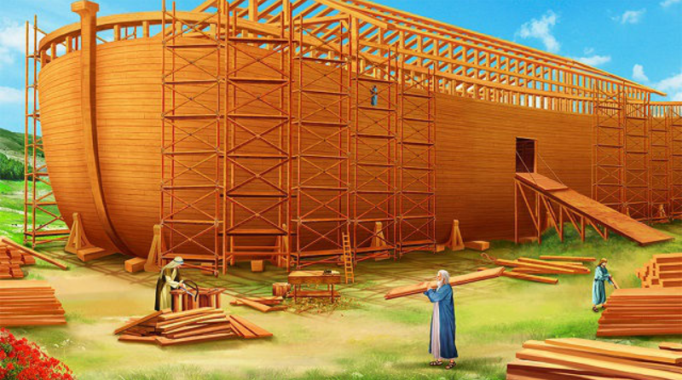
Noah, his wife, their sons and their wives began the enormous task God had given them.
The ark had to be big enough to hold two of every living creature.
Noah cut down trees for wood and he worked non stop to make the ark.

Slide 9
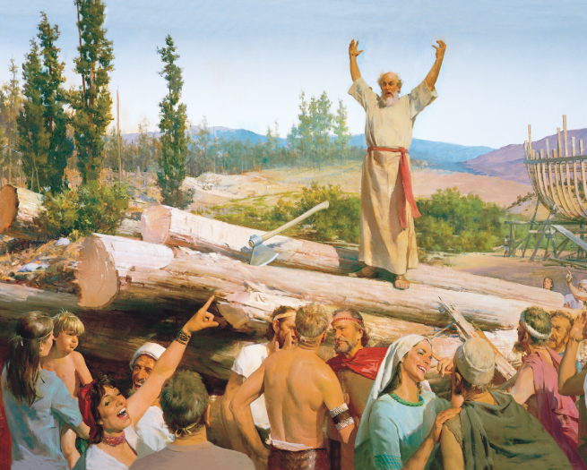
Noah tried to speak with people and was hoping that they would apologise to God so that God could forgive them and come onto the ark.
But people did not listen to Noah.

Slide 10
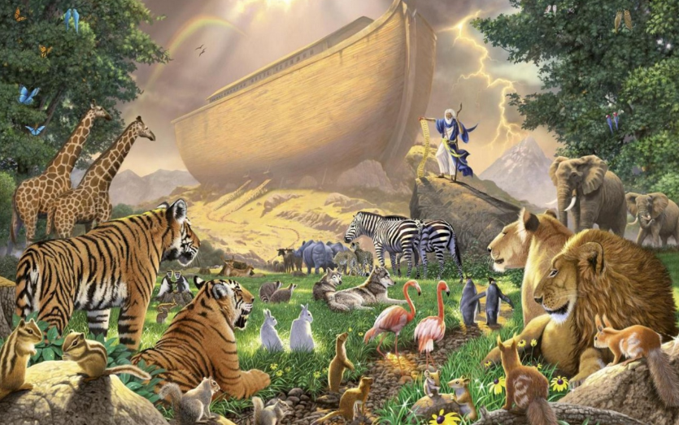
Noah collected one pair of every animal, just as God had asked him to.
The animals walked, hopped, crawled, slithered and were carried two by two onto the ark.

Slide 11
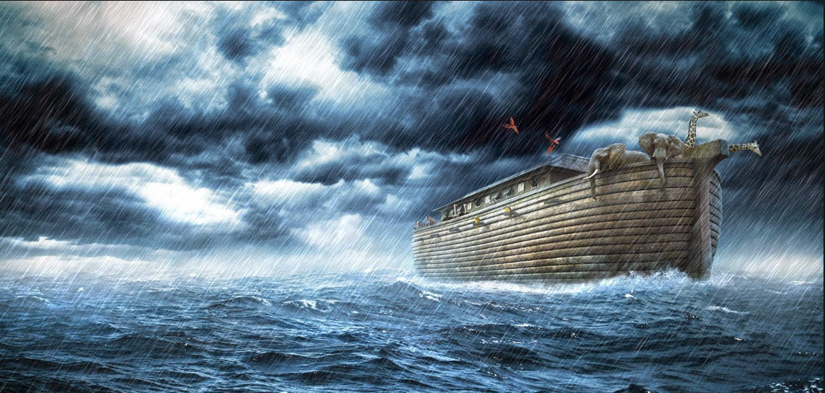
God sent the first storm clouds and it began to rain. Rivers, lakes and oceans quickly swelled.
Water flooded the land and the ark floated away.

Slide 12
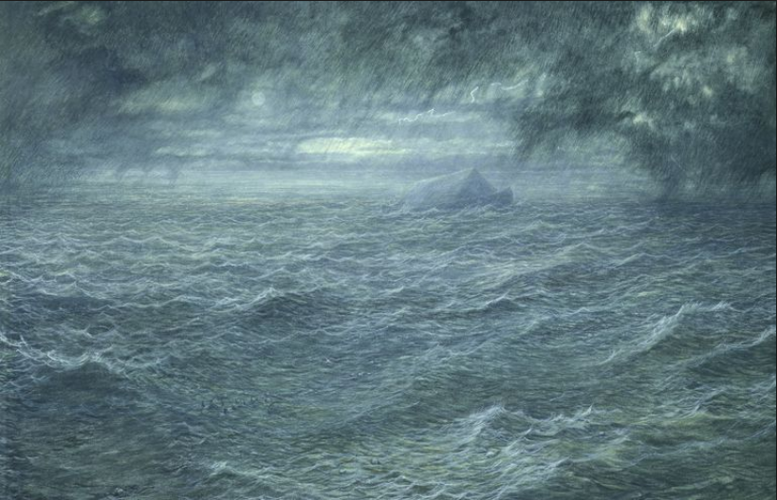
It rained and it rained, and the world was washed clean by the enormous flood as God had wished. Soon even the highest mountains were covered by the water, and still the rain came.
It rained for forty days and forty nights, then as quickly as it started, it stopped.

Slide 13
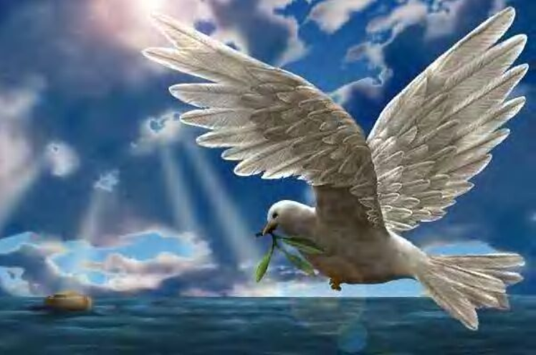
Noah waited and then he sent out a raven.
“ If there is dry land anywhere the raven will find it” he said to himself. But the raven soon came back to the ark.
Noah waited again and then sent out a dove. This time the dove flew back with an olive branch. When Noah sent out the dove the next time, it did not return.
The dove had found land.

Slide 14
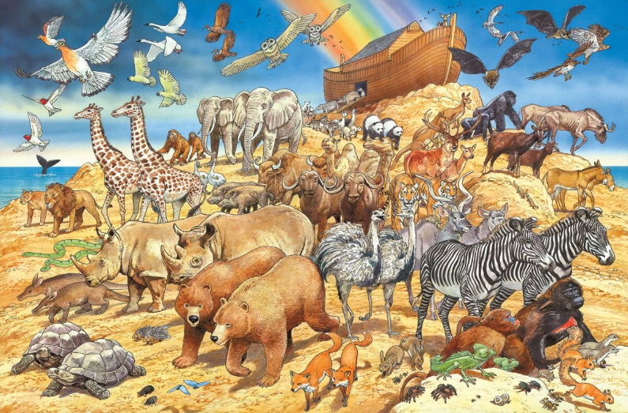
At last the great ark door creaked open.
“Go out into the world with the creatures and begin again,”

Slide 15
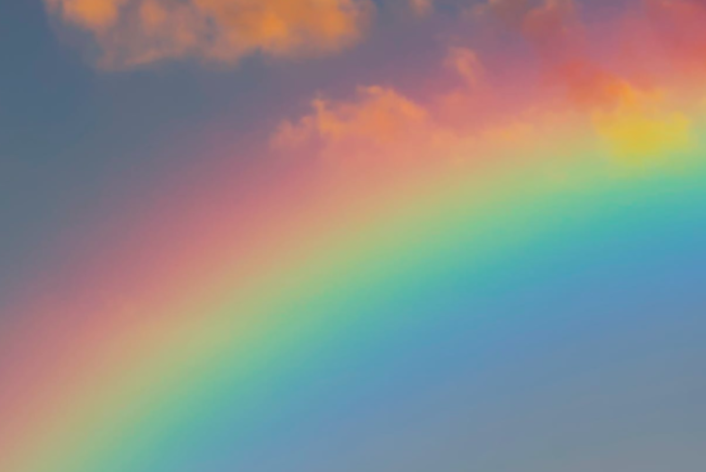
God promised never to flood the world again. As a sign of his vow, he made a glorious glowing rainbow to remind everyone of his promise.

Slide 16

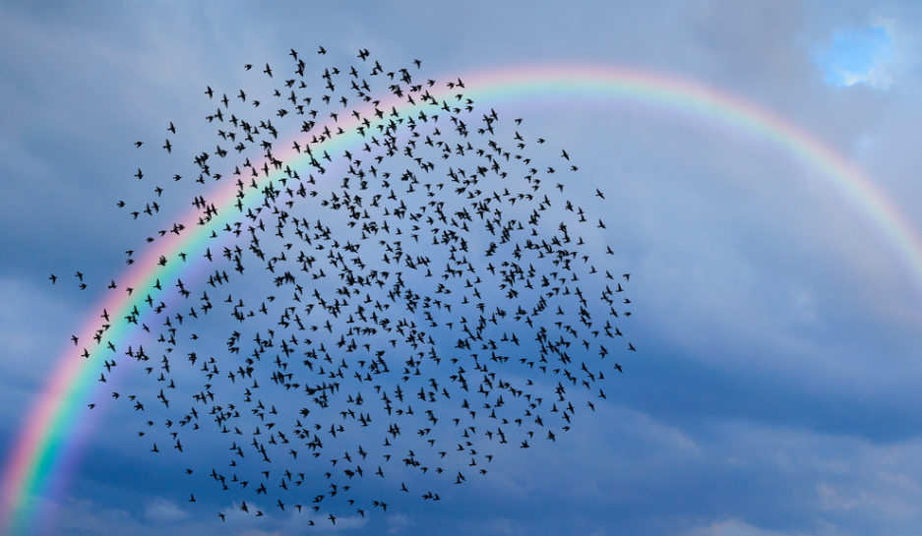
By following
our vision
and 6R’s
all our class birds
including
Robins, Owls,
Sparrows,
Kingfishers,
Swallows, Doves
and Eagles can
fly for gold
on our
class rainbows.

