Slide 1
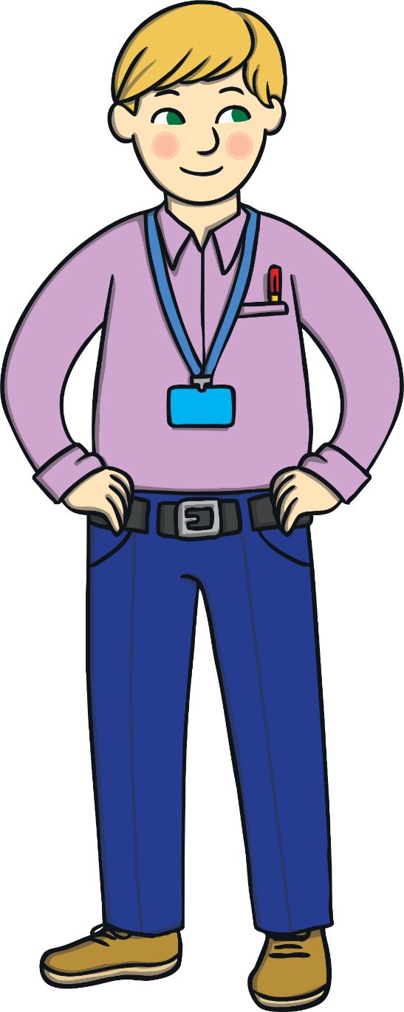
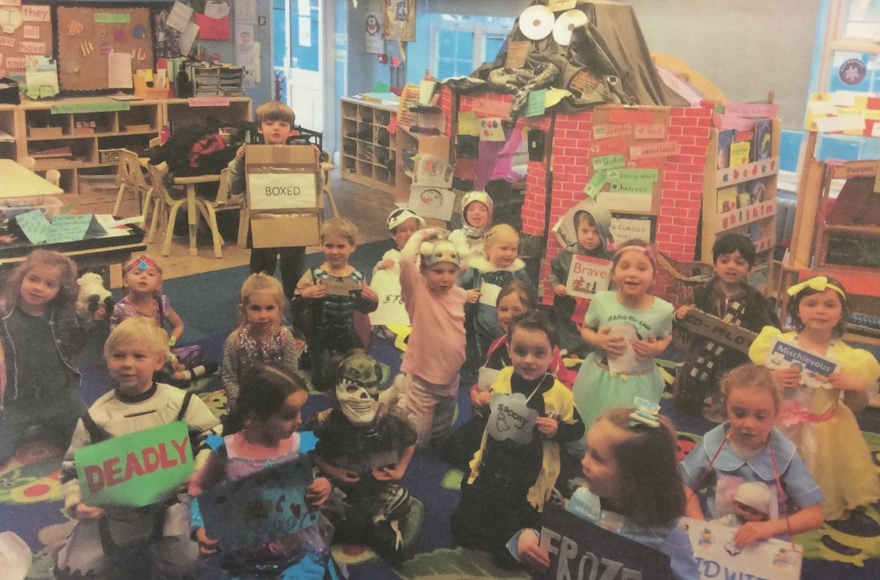
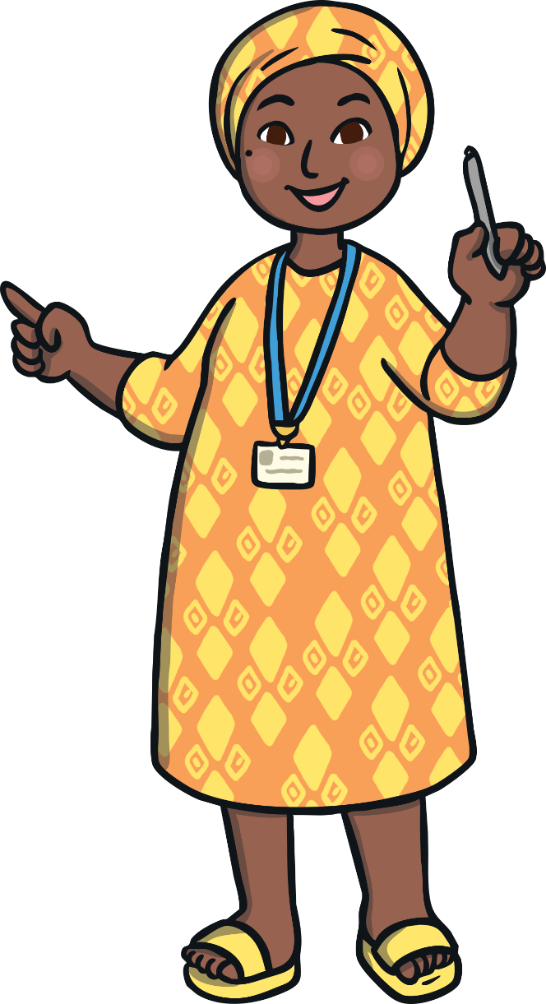
Our Class memories
Robin Class 19/20
Insert a picture here
Please note that when sharing photographs of children, all teachers should first check their school’s safeguarding policy and any relevant permissions which may have been obtained from parents and carers.

Slide 2
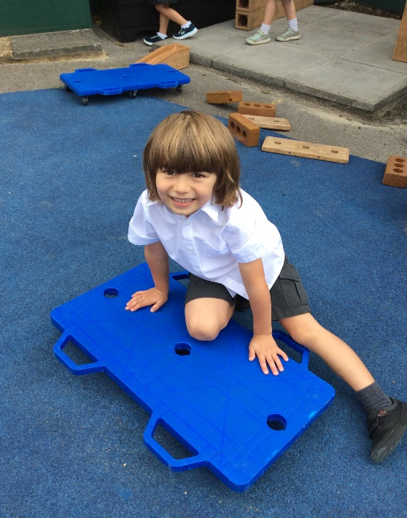
My Memories of Robin Class by Max
I love my learning.
My special friends are Thomas, Kavi, William and Jude.
I love playing outside and building robots and different things with the blocks.

Slide 3
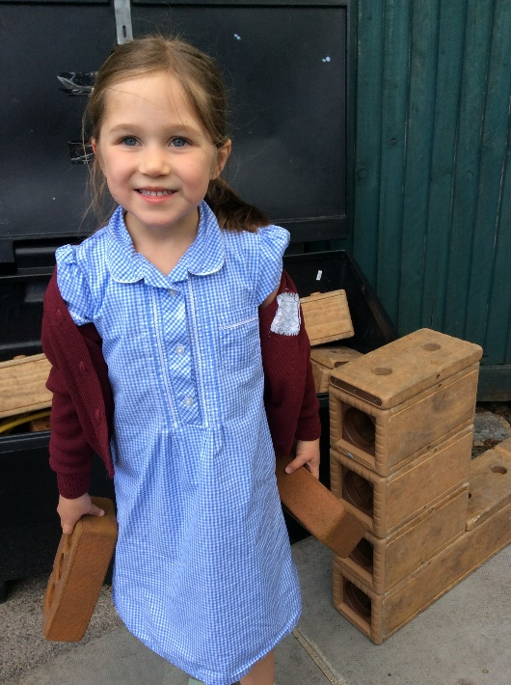
My Memories of Robin Class by Lucy
I have loved all the learning and especially when we learnt about the rainforest and different reptiles. I am now good at Writing. I will miss our reading area.

Slide 4
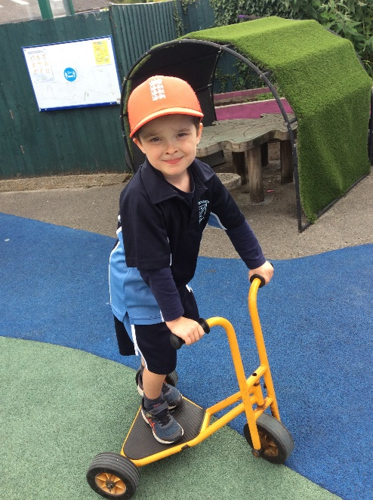
My Memories of Robin Class by Harry
I always will remember colouring and having so much fun. Even in the coronavirus we did good learning. I will miss Miss Nicholson.

Slide 5
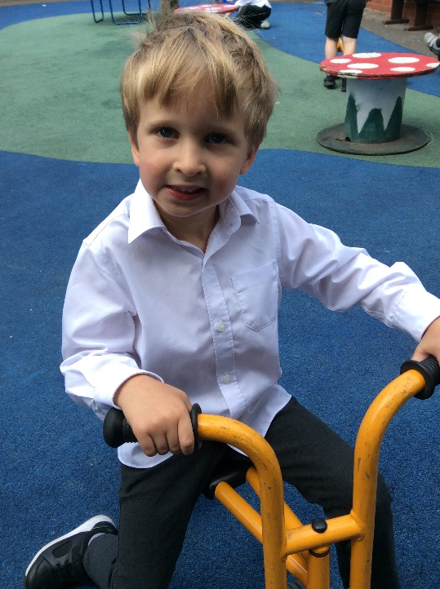
My Memories of Robin Class by William
I loved it when me Kavi and Max made spaceships using the lego.
I love going to assembly and seeing what class was going to get the golden spoon and Robin class got it lots.

Slide 6
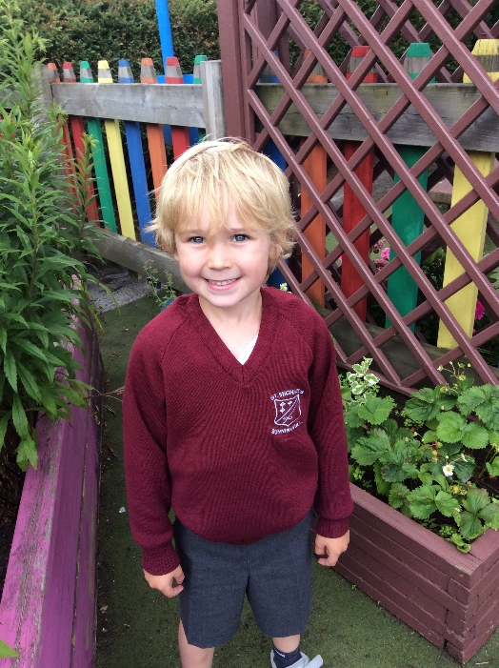
My Memories of Robin Class by Jude
I loved our learning about Elmer the elephant.
I liked making my own one and now it lives on the table by my bed.

Slide 7
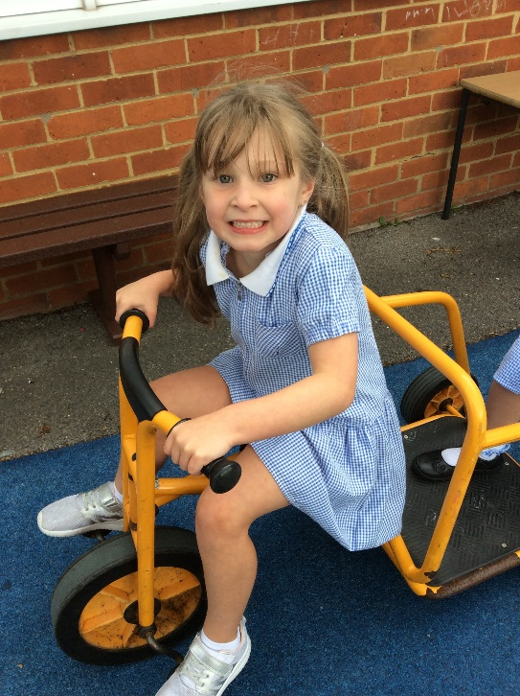
My Memories of Robin Class Phoebe
I love doing my school work. I will miss my activities and my teachers. I like wearing my summer dress now.

Slide 8
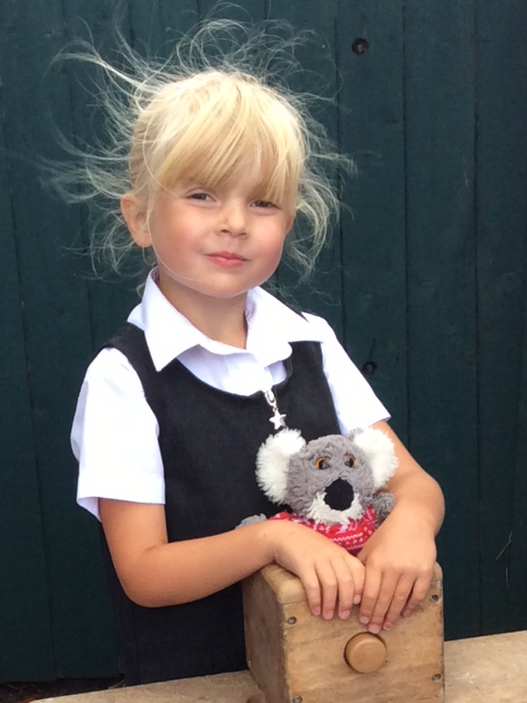
My Memories of Robin Class by Emilia
I love PE.
It was really funny when Oscar had a pirate hat and eyepatch like us for Pirate day!

Slide 9
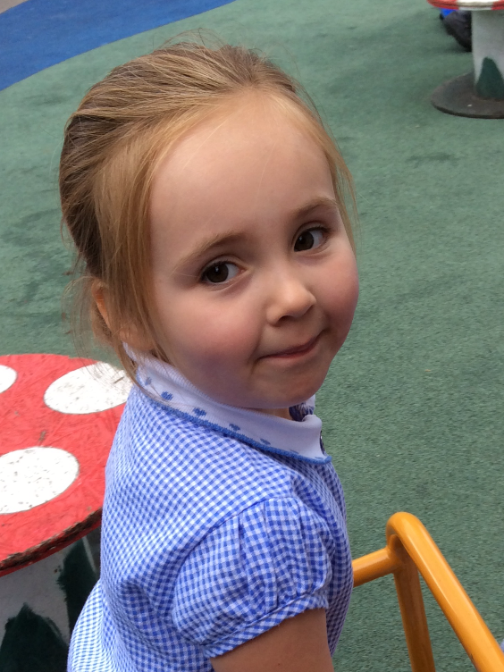
My Memories of Robin Class by Valentina
I love drawing and learning.
My favourite thing is Phonic time with Fred Frog, he is a cheeky frog you know.

Slide 10
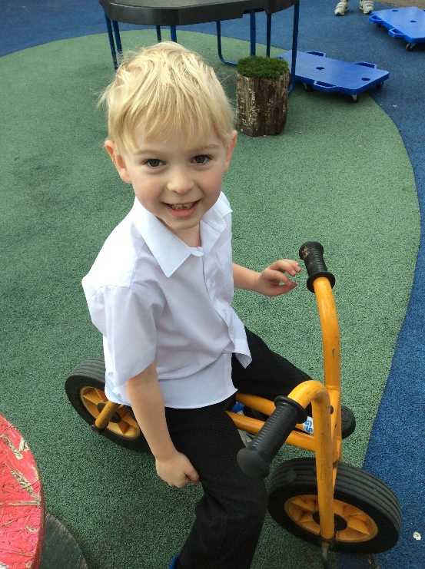
My Memories of Robin Class by Thomas
I love the outside area playing with my friends Max and William and Harry. I liked our carpet mat and I’ll miss my ladybird spot.

Slide 11
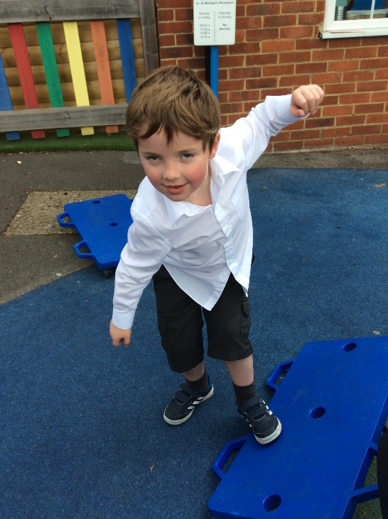
My Memories of Robin Class by Hugo
My best things are meeting Jude and my friends and playing with the lego. I loved our learning about Superheroes with the ‘Supertato’ books.

Slide 12
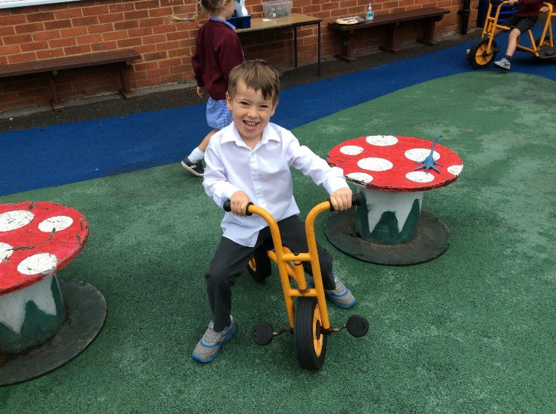
My Memories of Robin Class by Jacob
I love making things like nests with the Autumn leaves and collecting them from the big playground.

Slide 13
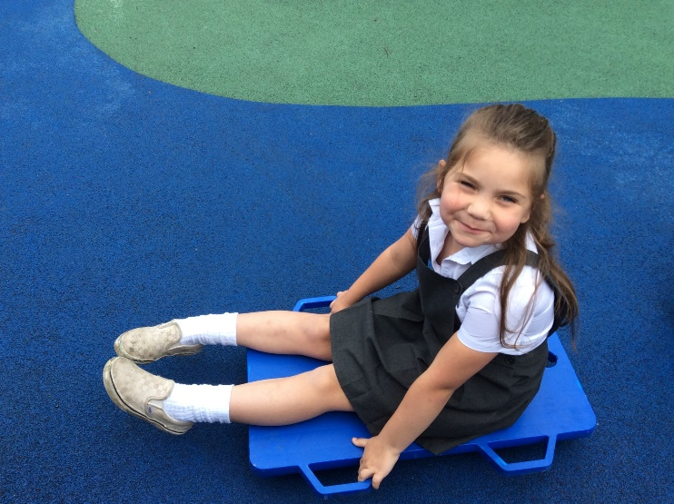
My Memories of Robin Class by Purdi
I liked making the marshmallow snowman biscuits- I left my one out for Santa. Baking in Robin class is fun.

Slide 14
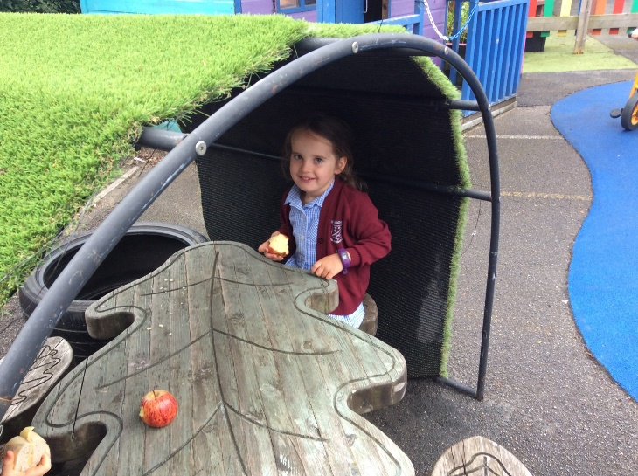
My Memories of Robin Class by Lilian
I really liked the story of the Cautious Caterpillar when she turns into a butterfly. It was a good book to talk about Year 1.

Slide 15
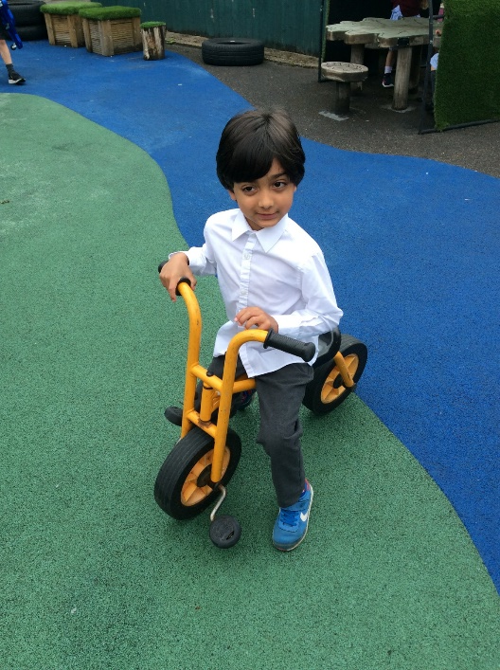
My Memories of Robin Class by Kavi
I love all the good learning. I cant wait for my sister Leela to come to Robin class as well because she will love it.

Slide 16
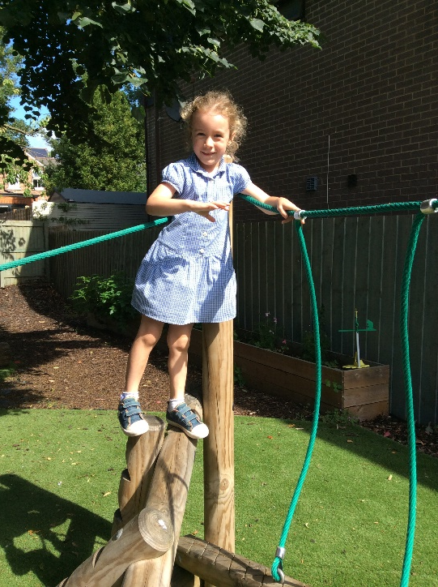
My Memories of Robin Class by Bethany
I like writing letters to our class fairies. I now write letters to my fairies at home too because I have a fairy door as well!

Slide 17
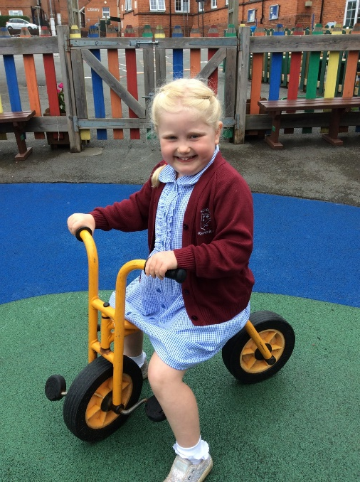
My Memories of Robin Class by Charlotte
I liked doing our Christmas Nativity. I love it as well when we find ice outside when it is cold in the Winter.

Slide 18
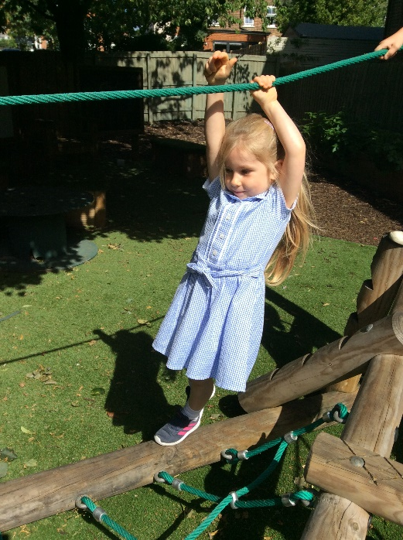
My Memories of Robin Class by Evie
I love doing lots and lots of Reading and I love doing such good drawings at School.

Slide 19
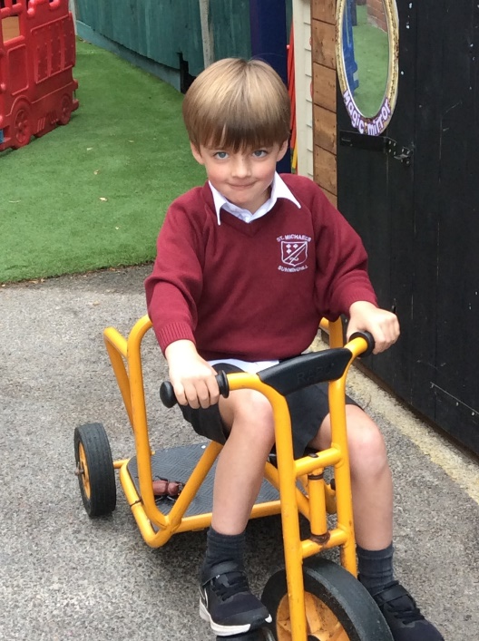
My Memories of Robin Class by Grayson
I loved making the masking tape town all over the carpet in our classroom with Jude.
It was sooo big!

Slide 20
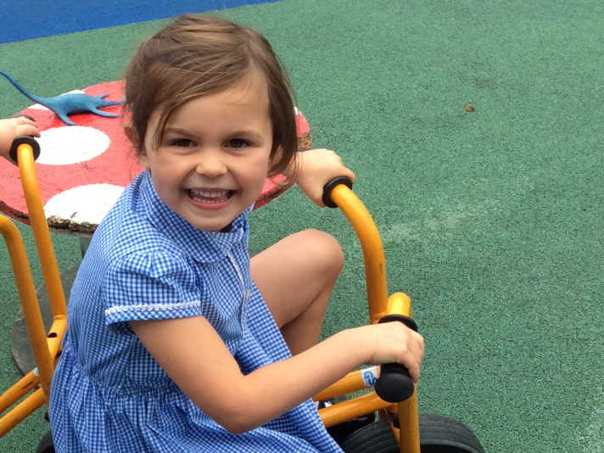
My Memories of Robin Class by Lily
I loved making the magic potion with Miss Nicholson in phonics, it was sooo much fun.

Slide 21
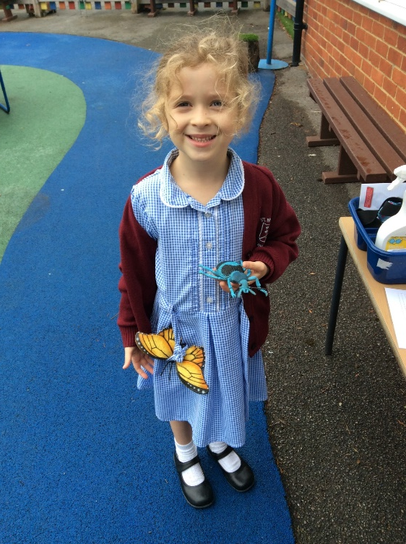
My Memories of Robin Class by Lois
I have lots of lovely friends now.

Slide 22
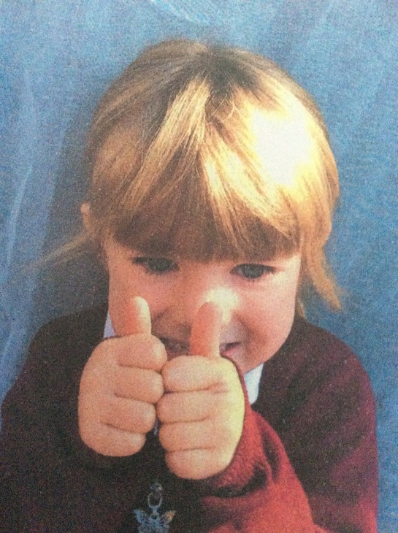
Some Memories about Primrose by Robin Class
Primrose loves chocolate- Max
I helped Primrose when she fell over- Harry
She is one of my best friends- Phoebe
I love crafting with her- Emilia
Soon she wil be in Year 1 with us.

