Slide 2
1
This word is something that you might see in the sky.
Next
cloud
cl d
Clue
Next
Next
Fill in the missing sound on your answer sheet.
Fill in the missing sound on your answer sheet.
Answer
Answer
Next

Slide 3
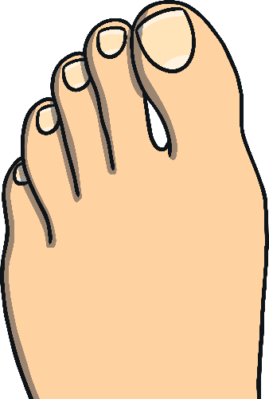
2
You can find five of these on a foot.
Next
toes
Clue
Next
Next
Write the word and use the sound buttons to help you.
Write the word and use the sound buttons to help you.
Answer
Answer
Next

Slide 4
3
This word is something that you can colour a picture with.
Next
cr on
crayon
Clue
Next
ea ay ie
ea ay ie
Next
Circle the missing sound on your answer sheet.
Circle the missing sound on your answer sheet.
Answer
Answer
Next

Slide 5
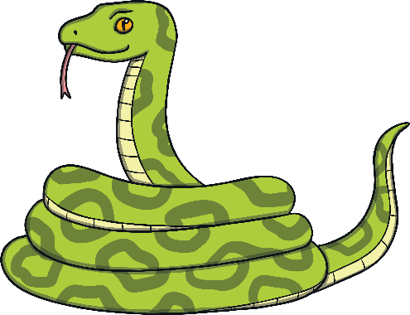
4
This animal is long and makes a hissing sound.
snake
Next
Clue
Next
Next
Count how many sounds you can hear in this word.
Count how many sounds you can hear in this word.
Answer
Answer
four sounds
four sounds
Next
Next

Slide 6
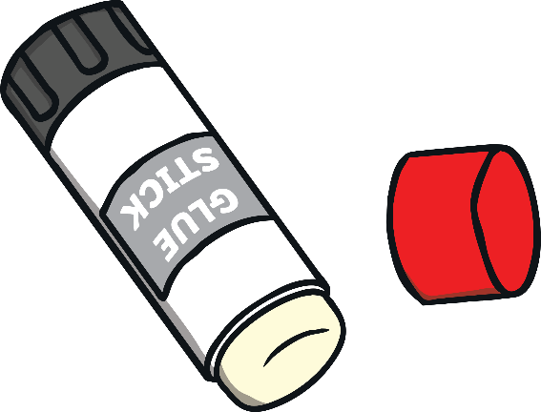
5
This word is something that helps you stick things together.
Next
glue
Clue
Next
Next
Write the word and use the sound buttons to help you.
Write the word and use the sound buttons to help you.
Answer
Answer
Next

Slide 7
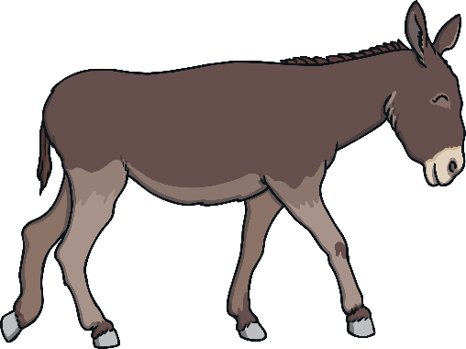
6
You can ride on this animal.
Next
donkey
donk
Clue
Next
Next
Fill in the missing sound on your answer sheet.
Fill in the missing sound on your answer sheet.
Answer
Answer
Next

Slide 8
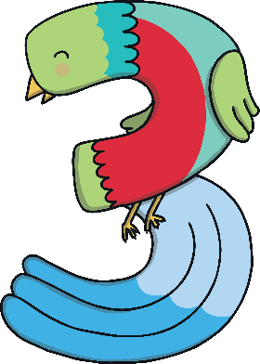
7
This number comes after 12.
Next
th teen
th irteen
Clue
Next
ir ay au
ir ay au
Next
Circle the missing sound on your answer sheet.
Circle the missing sound on your answer sheet.
Answer
Answer
Next

Slide 9
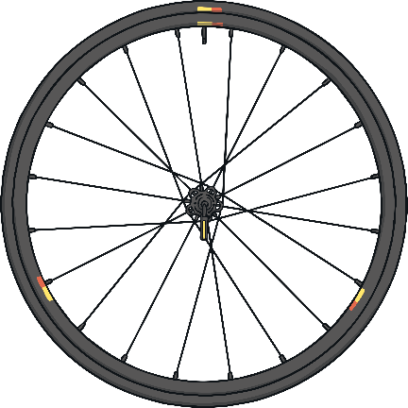
8
You would usually find two of these on a bike and four of them on a car.
Next
wheels
Clue
Next
Next
Write the word on your answer sheet.
Write the word on your answer sheet.
Answer
Answer
Next

Slide 10
9
This word is something smart that you might wear around your neck.
Next
tie
Clue
Next
Next
Write the word on your answer sheet.
Write the word on your answer sheet.
Answer
Answer
Next

Slide 11
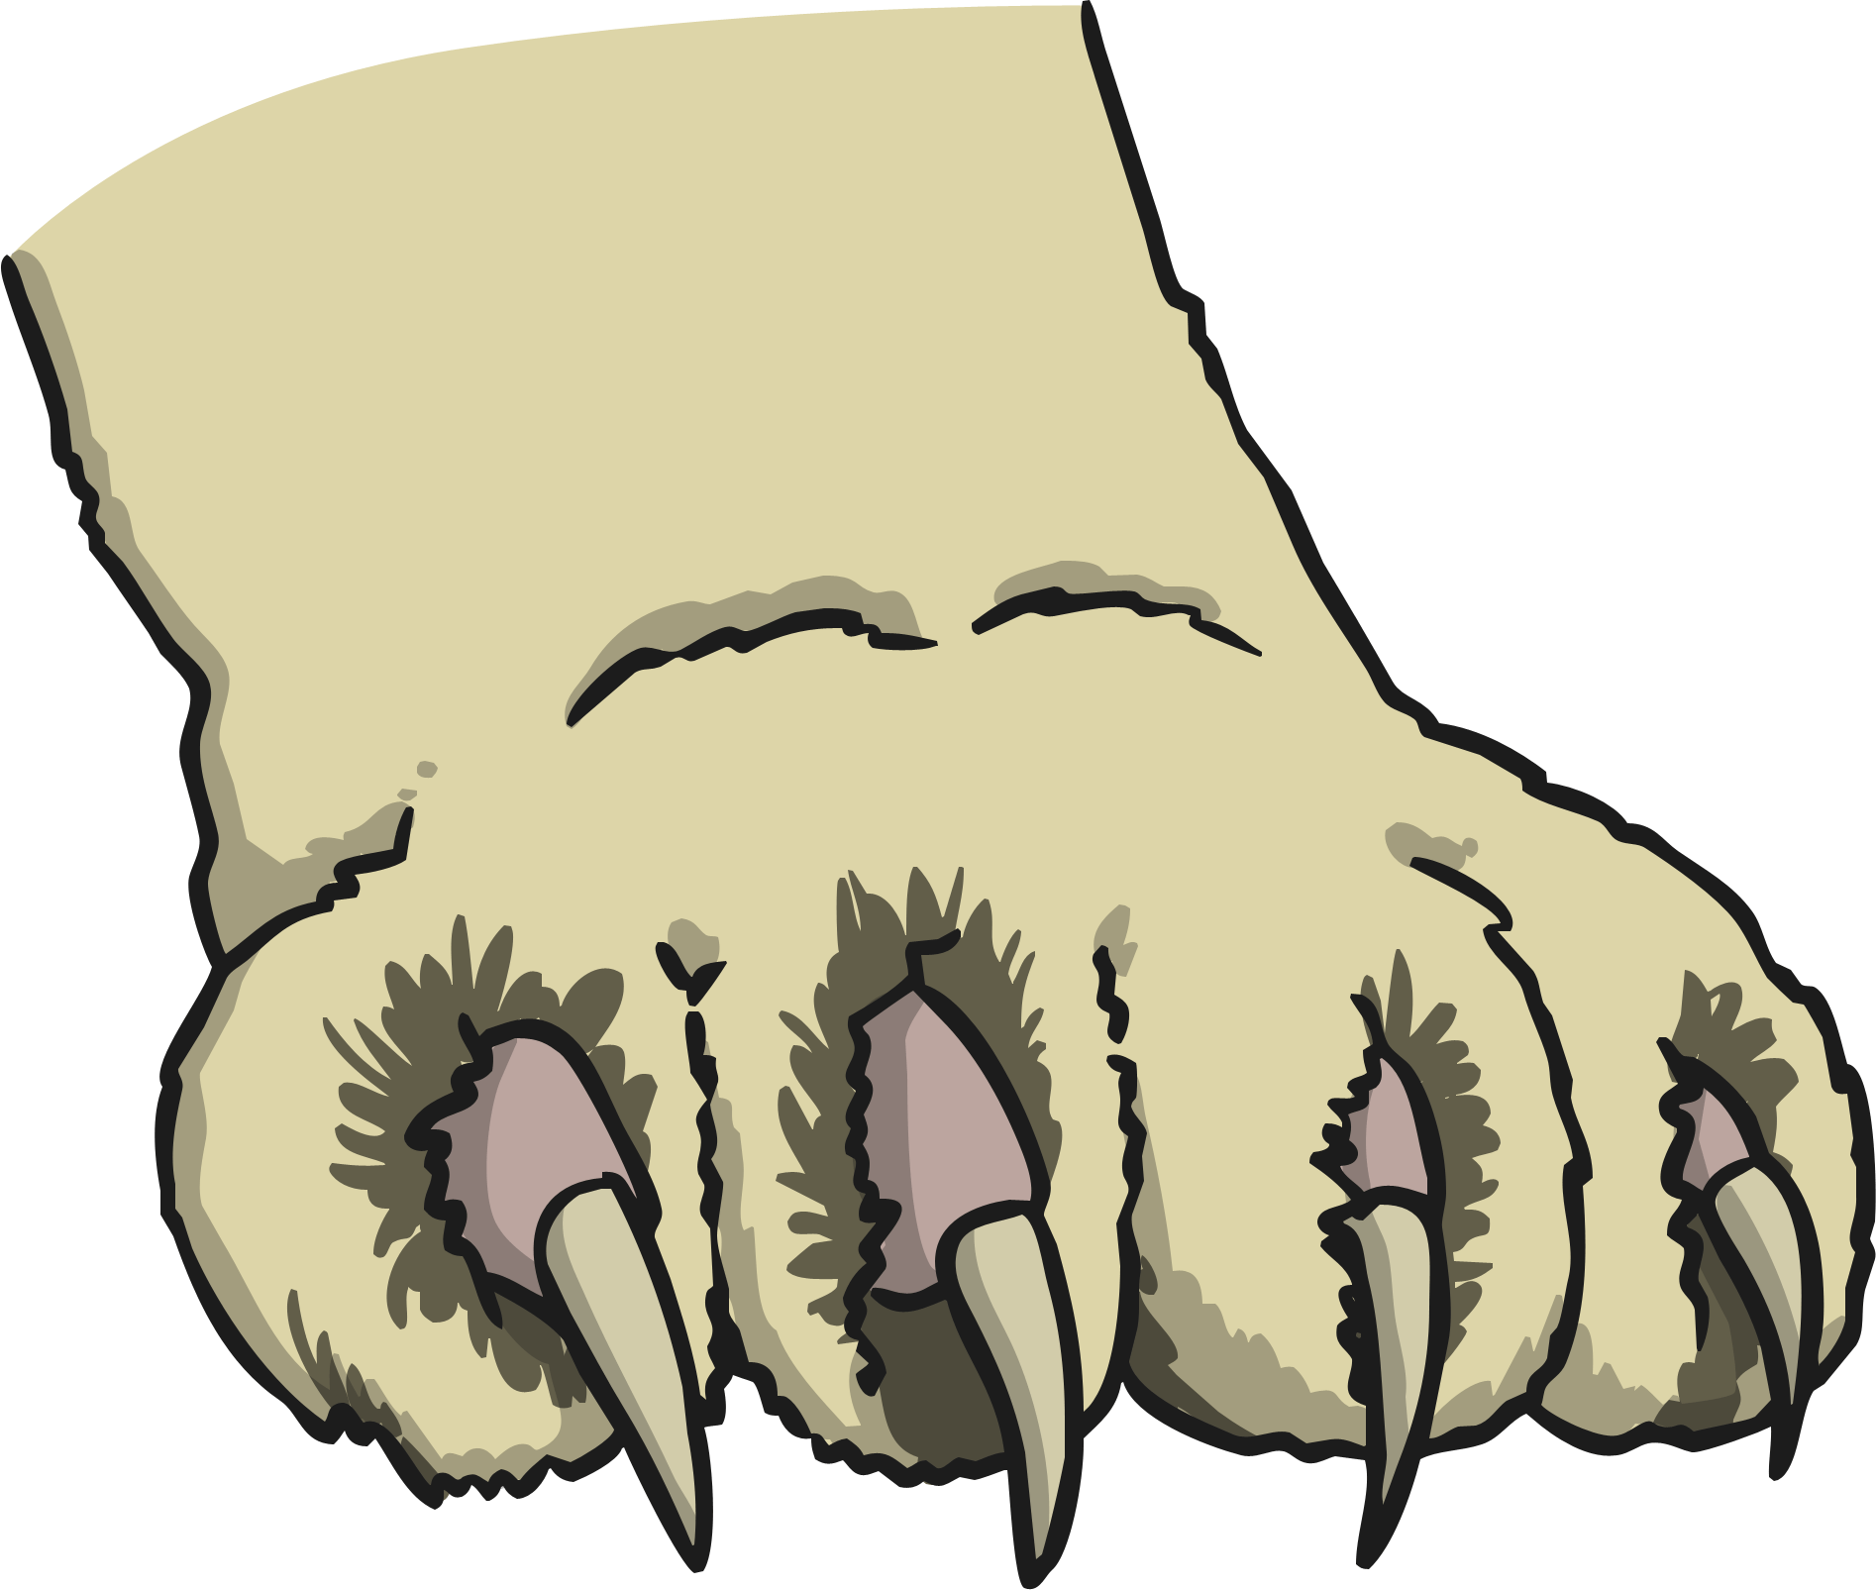
10
You would find these on a cat’s paw.
Next
claws
cl s
Clue
Next
Next
Fill in the missing sound on your answer sheet.
Fill in the missing sound on your answer sheet.
Answer
Answer
Next

Slide 12
11
This word is something that you do with a book.
Next
read
Clue
Next
Next
Count how many sounds you can hear in this word.
Count how many sounds you can hear in this word.
three sounds
three sounds
Answer
Answer
Next
Next

Slide 13
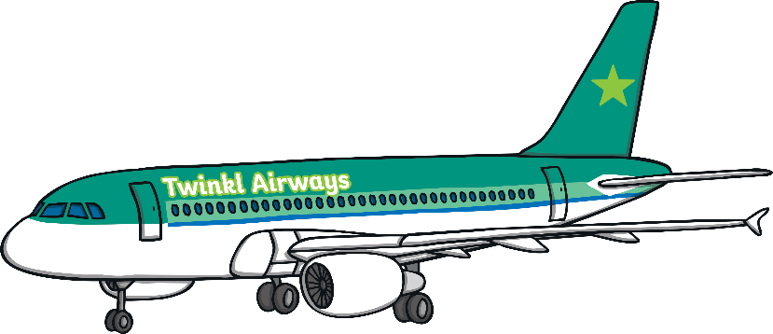
12
The plane across the sky last night.
flew
Next
Fill in the missing word in the sentence.
Clue
Answer
fl
flew
Answer
Next

Slide 14
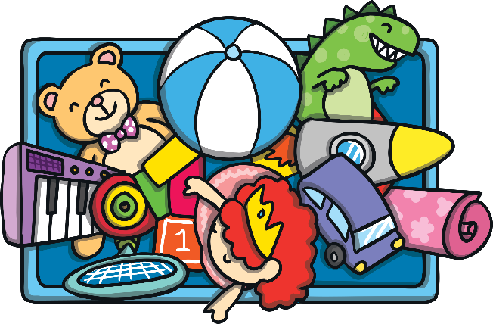
13
This word is something that children play with.
Next
t s
toys
Clue
Next
Next
Fill in the missing sound on your answer sheet.
Fill in the missing sound on your answer sheet.
Answer
Answer
Next

Slide 15
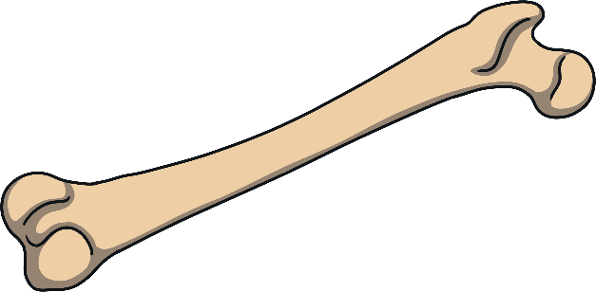
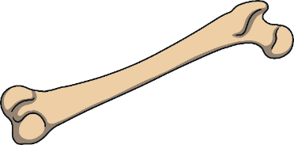
14
You can find these inside your body.
Next
bones
b n s
Clue
Next
Next
a-e i-e o-e
a-e i-e o-e
Circle the missing sound on your answer sheet.
Circle the missing sound on your answer sheet.
Answer
Answer
Next

Slide 16
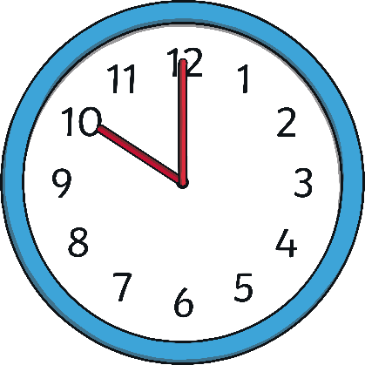
15
Use the clock to tell the .
time
Next
Fill in the missing word in the sentence.
t m
time
Clue
Answer
Answer
Next

